Slide 1
Supervised Learning

Slide 2
Supervised Machine Learning
Supervised learning is the type of machine learning in which machines are trained using well "labelled" training data, and on basis of that data machines predict the output.
The labelled data means some input data is already tagged with the correct output.
In supervised learning, the training data provided to the machines work as the supervisor that teaches the machines to predict the output correctly.
It applies the same concept as a student learns in the supervision of the teacher.
Supervised learning is a process of providing input data as well as correct output data to the machine learning model.
The aim of a supervised learning algorithm is to find a mapping function to map the input variable(x) with the output variable(y).
In the real-world, supervised learning can be used for Risk Assessment, Image classification, Fraud Detection, spam filtering, etc.

Slide 3
Steps Involved in Supervised Learning:
First determine the type of training dataset
Collect/Gather the labelled training data.
Split the training dataset into training dataset, test dataset, and validation dataset.
Determine the input features of the training dataset, which should have enough knowledge so that the model can accurately predict the output.
Determine the suitable algorithm for the model, such as support vector machine, decision tree, etc.
Execute the algorithm on the training dataset. Sometimes we need validation sets as the control parameters, which are the subset of training datasets.
Evaluate the accuracy of the model by providing the test set. If the model predicts the correct output, which means our model is accurate.

Slide 4
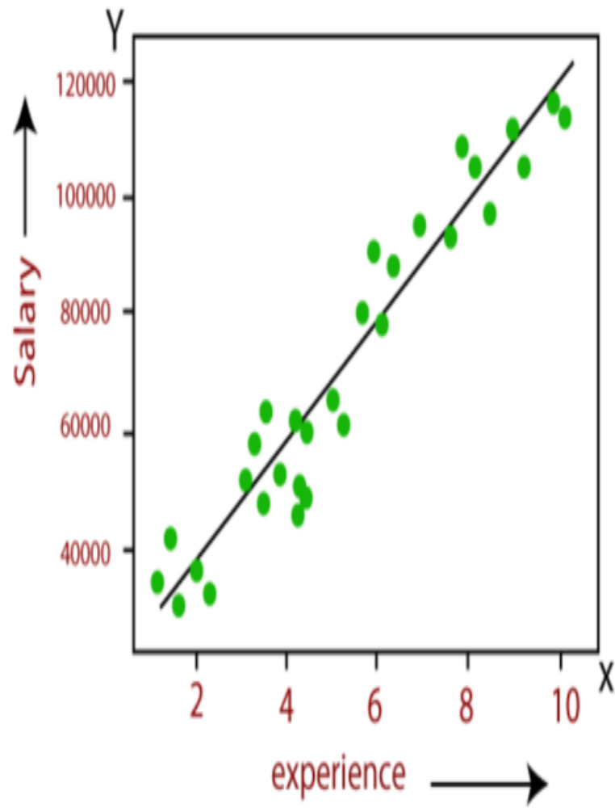
Linearity
Linearity refers to the property of a system or model where the output is directly proportional to the input, while nonlinearity implies that the relationship between input and output is more complex and cannot be expressed as a simple linear function
A linear model essentially fits a straight line to the data, allowing it to make predictions based on a linear relationship between the input features and the output variable
In a regression problem, a linear model is used to predict a continuous target variable based on one or more input features, such as predicting the salary of an employee on the basis of the year of experience

Slide 5
Linearity
Simple linear regression utilizes the linear equation:
y = b0 + b1*x1
where y is the dependent variable (what we want to predict),
x1 is the independent variable or feature,
b0 is the y-intercept or a constant, and
b1 is the slope coefficient.
Regression is used when you want to predict a real value.
For example, predicting the output of potatoes from the amount of fertilizer a farmer chooses to use.
The amount of fertilizer is the independent variable or the feature (x1),
while the dependent variable is the output of potatoes (y).
This would make the equation look like this:
Potatoes = b0 + b1*Fertilizer for our linear regression model.

Slide 6
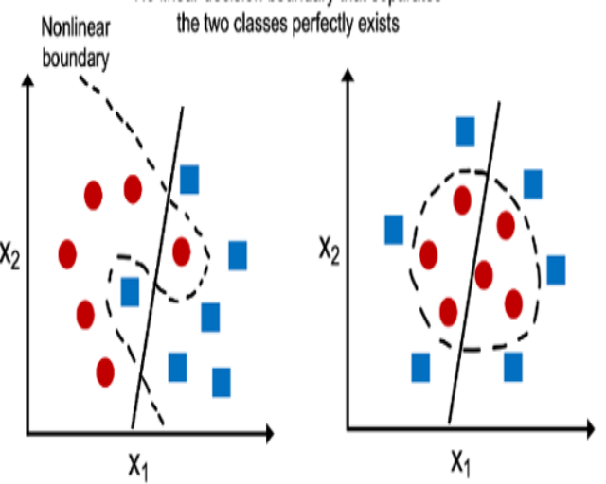
Non Linearity
Nonlinear models can take many forms, from polynomial models that fit curves to the data, to neural networks that can learn complex patterns in high-dimensional data.
These models are often more powerful than linear models because they can capture more complex relationships between variables.
In a classification problem, nonlinear models are able to identify complex decision boundaries that separate different classes, especially when those boundaries are not linear.
Nonlinear models can be more challenging to work with than linear models.
They often require more training data, computational power, and tuning to obtain good results. However, nonlinear models are better suited for real-world problems and allow data scientists to find trends that would otherwise be impossible to detect

Slide 7
Linear Model
A model where the output is a linear combination of parameters.
  Formula: ŷ = θ₀ + θ₁x₁ + θ₂x₂ + ... + θₙxₙ
  Non Linear Model
  A model where the relationship between variables is curved or complex.
  Output is NOT a linear combination of parameters.

Slide 8
Examples of Linear Models
• Linear Regression
Formula: ŷ = β₀ + β₁x
• Logistic Regression
Formula: p = 1 / (1 + e^-(β₀ + β₁x))
• Linear SVM
Decision boundary: wᵀx + b = 0

Slide 9
Examples of Non-Linear Models
• Polynomial Regression
Formula: ŷ = θ₀ + θ₁x + θ₂x² + ... + θₖxᵏ
• Decision Trees
(No explicit formula; split-based)
• SVM with RBF Kernel
Kernel: K(x, x') = exp(-γ||x - x'||²)
• Neural Networks
Formula: ŷ = f(W₂·σ(W₁x + b₁) + b₂)

Slide 10
Linear vs Non-Linear Models
Linear → Straight-line decision boundary
Non-linear → Curved/complex boundary

Slide 11
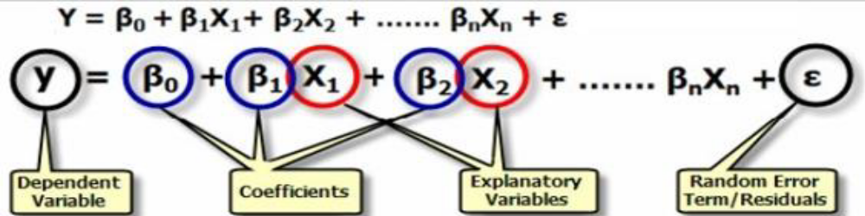
The motivation for using the regression technique:
  Forecast the value of a dependent variable (y) from the value of independent variables
  Analyze the specific relationships between the independent variables and the dependent variable.
Model based on Regression Learning algorithm

Slide 12
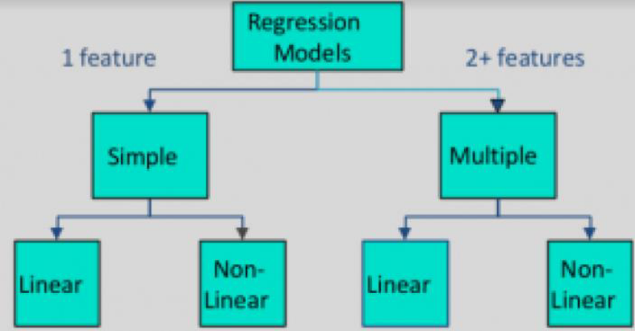
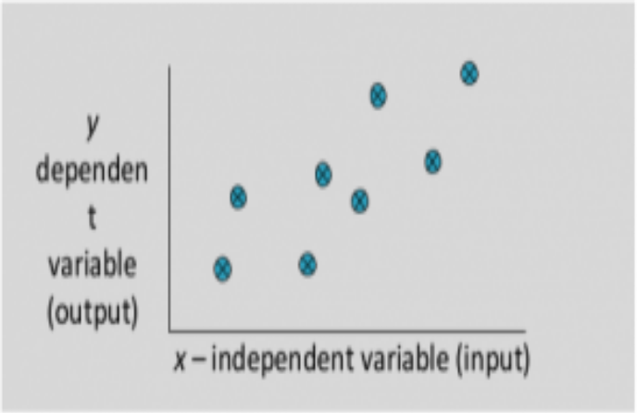
Regression
A regression problem is when the output variable is either real or a continuous value i.e salary, weight, area, etc.
Types of Regression Models

Slide 13
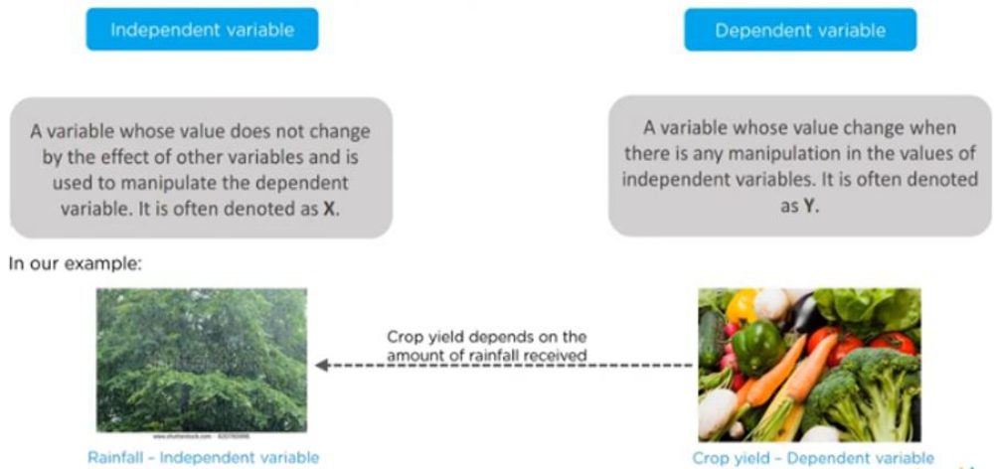
Regression
Independent Vs Dependent Variable

Slide 14
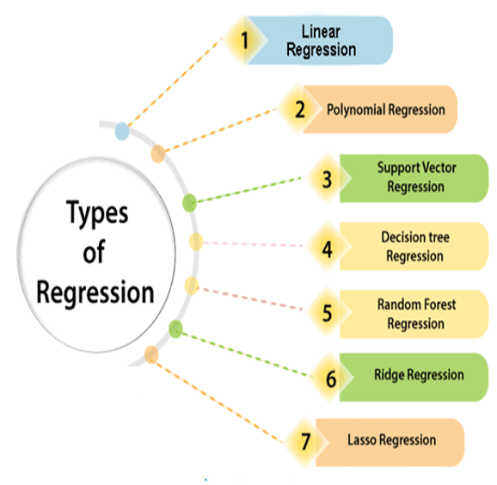
Regression
Regression algorithms are used if there is a relationship between the input variable and the output variable.
It is used for the prediction of continuous variables, such as Weather forecasting, Market Trends, etc.

Slide 15
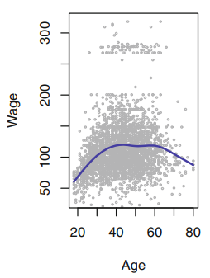
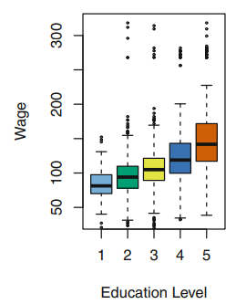
Real Time Regression Applications
The Wage data involves predicting a continuous or quantitative output value.
This is often referred to as a regression problem

Slide 16
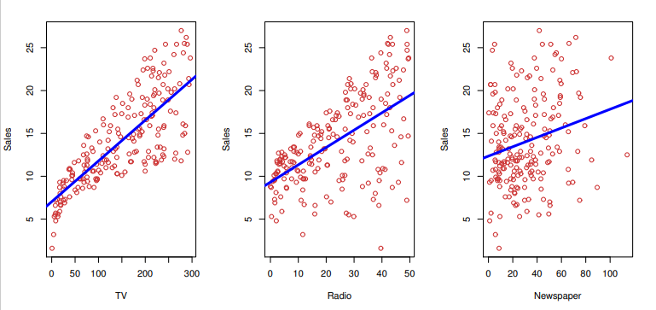
Real Time Regression Applications- Advertising Data
Input Variables: Advertising budgets
Input Variables are denoted by X
X₁ – TV budget
X₂ – Radio budget
X₃ – Newspaper budget
Input variables are called by different names like
Predictors
Independent variables
Features
Variables

Slide 17
Real Time Regression Applications- Advertising Data
Output Variable: Sales
Output Variables are denoted by Y
Output variables are called by different names like
Responses,
Dependent variables

Slide 18
Real Time Regression Applications- Advertising Data
There is some relationship between Y and X = (X₁, X₂,...,X_{p})
General form of relationship is
Y = f(X) + ε
Where,
f is some fixed but unknown function of X₁,...,X_{p}
ε is a random error term, which is independent of X and has mean zero

Slide 19
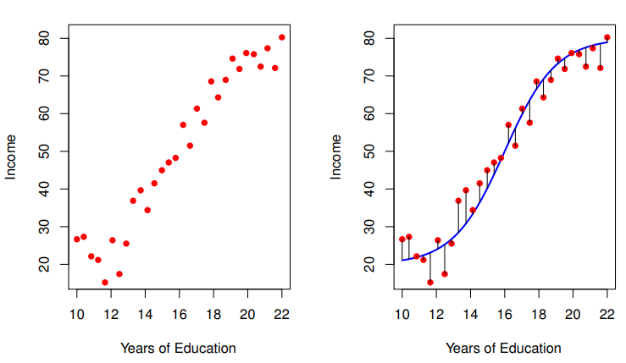
Real Time Regression Applications
The black lines represent the error associated with each observation.
Here some errors are positive (if an observation lies above the blue curve) and some are negative (if an observation lies below the curve)
Overall, these errors have approximately mean zero
Observed values of income and years of education for 30 individuals

Slide 20
Real Time Regression Applications- Advertising Data
The important questions are
Which media contribute more to sales?
Do all three contribute to sales, or do just one or two.
The individual effects of each medium on the money spent
For every dollar spent on advertising in TV or Radio or Newspaper, by what amount will sales increase?
How accurately can we predict this amount of increase?
Linear regression can be used to answer each of these questions

Slide 21
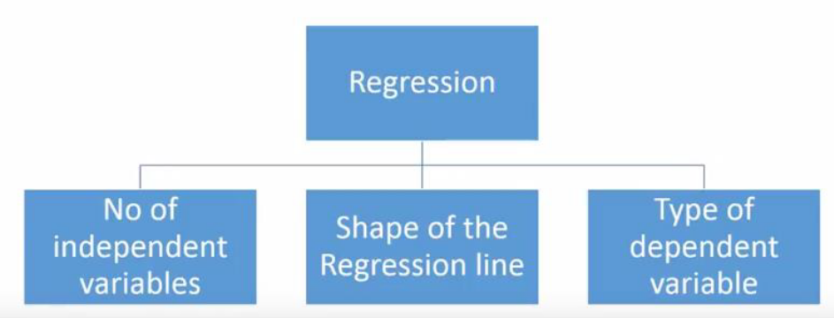


Linear Regression
Types of Linear Regression
Simple Linear Regression
Multiple Linear Regression
Polynomial Regression
Logistic Regression
p = 1 / (1 + e^-(β₀ + β₁x))

Slide 22
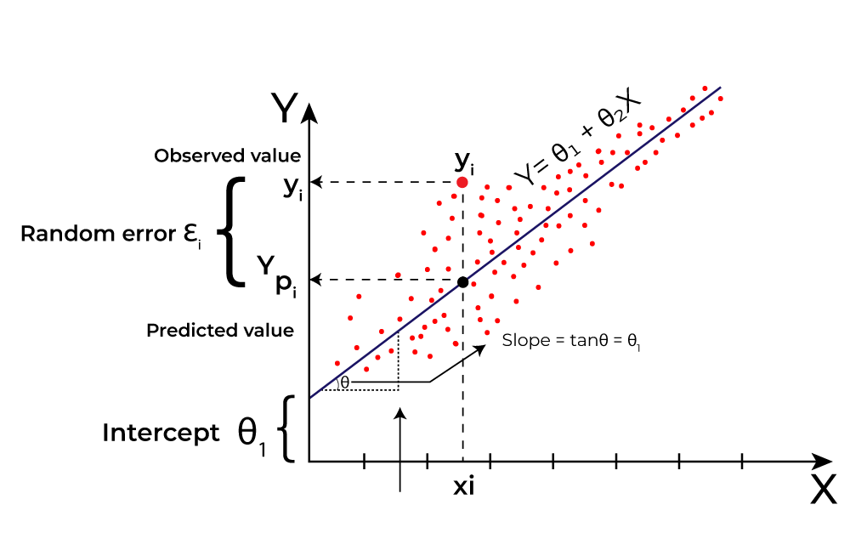
What is the best Fit Line?
Our primary objective while using linear regression is to locate the best-fit line, which implies that the error between the predicted and actual values should be kept to a minimum.
There will be the least error in the best-fit line.
The best Fit Line equation provides a straight line that represents the relationship between the dependent and independent variables.
The slope of the line indicates how much the dependent variable changes for a unit change in the independent variable(s).
The regression line is the best-fit line for our model.

Slide 23
Simple Linear Regression
Simple linear regression is a statistical method which is to summarize and study relationships between two continuous (quantitative) variables as dependent and independent.
It’s a common technique to determine how one variable of interest is affected by another.
A line is fitted through the group of plotted data (sample data- sample regression line)
The sample regression line provides an estimate of the population regression line
The linear model (i.e. first order linear model) :
y = dependent variable;
x = independent variable;
β0 = y-intercept
β1 = slope of the line ;
ε = error variable/residual value
β0 and β1 are unknown population parameters, and are estimated from the data.
The residual value (ε) is a discrepancy between the actual and the predicted value. The distance of the plotted points from the line gives the residual value.

Slide 24
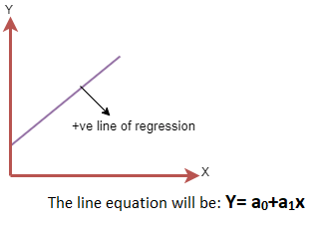
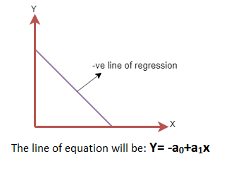
Linear Regression Line
Positive Linear Relationship:
If the dependent variable increases on the Y-axis and independent variable increases on X-axis, then such a relationship is termed as a Positive linear relationship.
Negative Linear Relationship:
If the dependent variable decreases on the Y-axis and independent variable increases on the X-axis, then such a relationship is called a negative linear relationship.

Slide 25
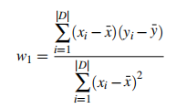

Least Square method - Linear Regression
Formula
Straight line

Slide 26
Linear Regression(LSM): Explanation with Example
Consider a simple dataset,
x | y
1 | 3
2 | 2
3 | 2
4 | 4
5 | 3

Slide 27
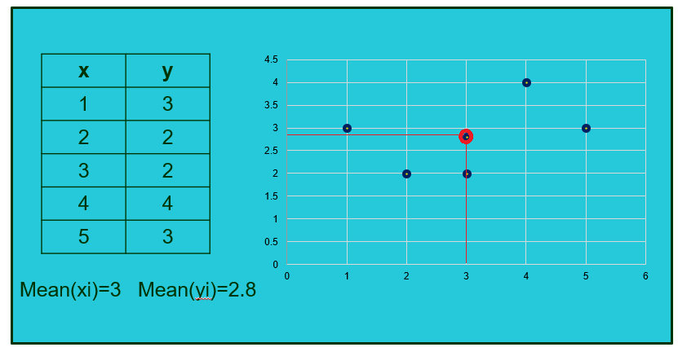
Linear Regression(LSM): Explanation with Example

Slide 28
Linear Regression(LSM): Explanation with Example
Total=10 Total=2
x | y | x-xi | y-yi | (x-xi) | (x-xi)(y-yi)
1 | 3 | -2 | 0.2 | 4 | -0.4
2 | 2 | -1 | -0.8 | 1 | 0.8
3 | 2 | 0 | -0.8 | 0 | 0
4 | 4 | 1 | 1.2 | 1 | 1.2
5 | 3 | 2 | 0.2 | 4 | 0.4

Slide 29
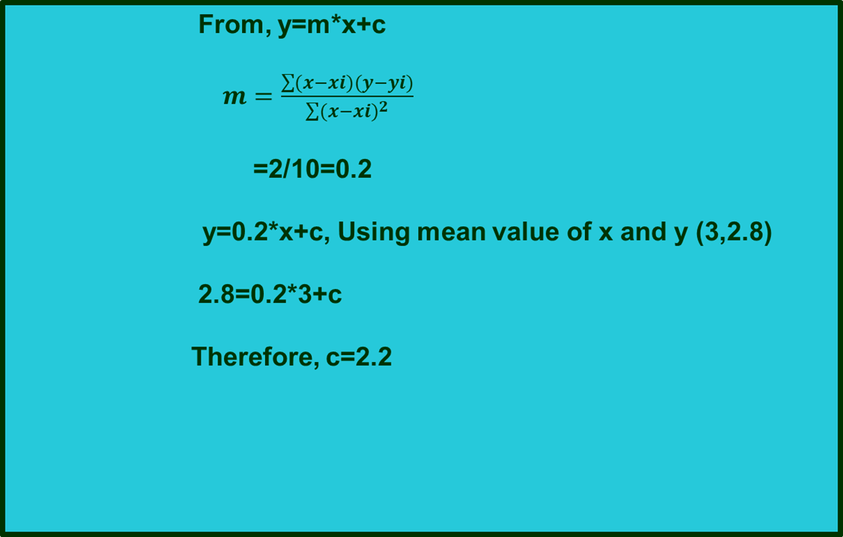
Linear Regression(LSM): Explanation with Example

Slide 30
Linear Regression(LSM): Explanation with Example
Predicting yp using x and plotting the points.
yp=(0.2*x)+2.2
yp=(0.2*1)+2.2=2.4
yp=(0.2*2)+2.2=2.6
yp=(0.2*3)+2.2=2.8
yp=(0.2*4)+2.2=3.0
yp=(0.2*5)+2.2=3.2

Slide 31
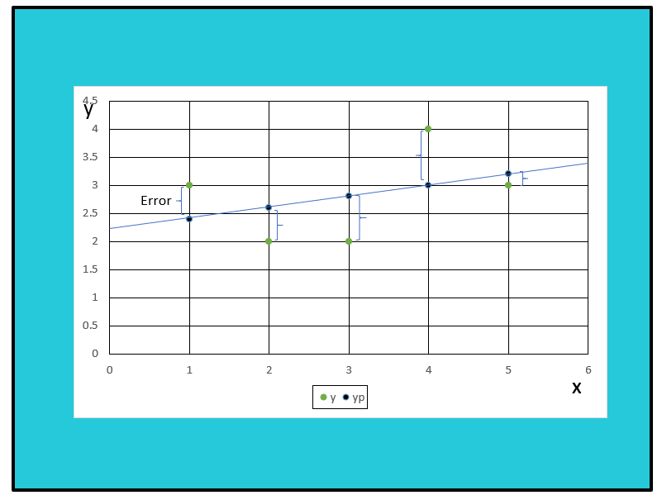
Linear Regression: Explanation with Example
We keep moving the line through the data points to make sure the best fit line has the least square distance between the data points and the regression line.

Slide 32
Evaluation metrics for Regression
A loss function in Machine Learning is a measure of how accurately your ML model is able to predict the expected outcome. In regression the following are the loss functions
Mean Absolute Error (MAE)
Mean Squared Error (MSE)
R-squared (R²) Score
Root Mean Squared Error (RMSE)

Slide 33
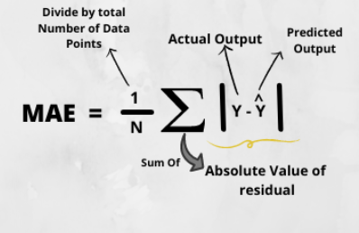
Mean Absolute Error (MAE)
We aim to get a minimum MAE because this is a loss.

Slide 34
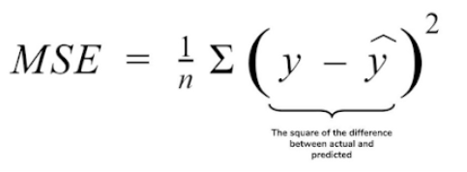
Mean Squared Error(MSE)
The lower the value the better and 0 means the model is perfect.

Slide 35

Root Mean Squared Error(RMSE)
This produces a value between 0 and 1, where values closer to 0 represent better fitting models. Based on a rule of thumb, it can be said that RMSE values between 0.2 and 0.5 shows that the model can relatively predict the data accurately.

Slide 36
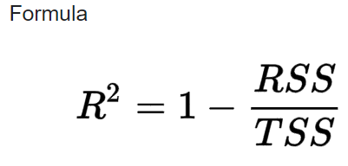
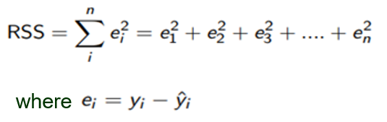
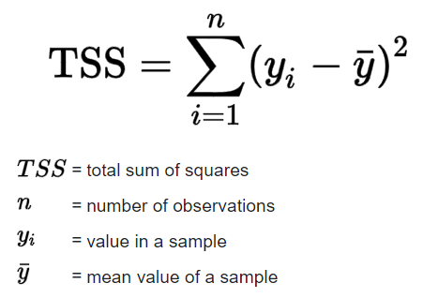
R-squared (R²) Score
R-squared, otherwise known as R² typically has a value in the range of 0 through to 1. The closer the r-squared value is to 1, the better the fit.
This is the difference between original and predicted sample
R2 squared is also known as Coefficient of Determination or sometimes also known as Goodness of fit

Slide 37
Multicollinearity
Multicollinearity occurs when two or more independent variables have a high correlation with one another in a regression model, which makes it difficult to determine the individual effect of each independent variable on the dependent variable.
The presence of multicollinearity can lead to unstable and unreliable coefficient estimates, making it challenging to interpret the results and draw meaningful conclusions from the model.
To detect multicollinearity
Calculate the variance inflation factor (VIF) for each independent variable, and a VIF value greater than 1.5 indicates multicollinearity.
To fix multicollinearity
Remove one of the highly correlated variables, combine them into a single variable, or use a dimensionality reduction technique such as principal component analysis to reduce the number of variables while retaining most of the information.

Slide 38
Correlation
If the correlation between two variables is +/- 1.0, then the variables are said to be perfectly collinear.
If there is no relationship at all between two variables, then the correlation coefficient will certainly be 0.
When the correlation coefficient is positive, an increase in one variable also increases the other.
When the correlation coefficient is negative, the changes in the two variables are in opposite directions.

Slide 39
Overfitting and Underfitting
Overfitting occurs when machine learning model tries to cover all the data points or more than the required data points present in the given dataset. Because of this, the model starts caching noise and inaccurate values present in the dataset, and all these factors reduce the efficiency and accuracy of the model. The overfitted model has low bias and high variance.
Note:
Bias: Bias is the difference between the predicted values and the actual values.(wrong assumptions)
Variance: If the machine learning model performs well with the training dataset, but does not perform well with the test dataset, then variance occurs.
Underfitting represents the inability of the model to learn the training data effectively result in poor performance both on the training and testing data. In simple terms, an underfit model’s are inaccurate, especially when applied to new, unseen examples.

Slide 40
Multilinear Regression
One of the most common types of predictive analysis is multiple linear regression.
This type of analysis allows you to understand the relationship between a continuous dependent variable and two or more independent variables.
The independent variables can be either continuous (like age and height) or categorical (like gender and occupation).
Here : Y = b0 + b1 * x1 + b2 * x2 + b3 * x3 + …… bn * xn
Y = Dependent variable and x1, x2, x3, …… xn = multiple independent variables

Slide 41
Assumptions of Multiple Linear Regression
A linear relationship should exist between the Target and predictor variables.
The regression residuals (errors) must be normally distributed.
MLR assumes little or no multicollinearity (correlation between the independent variable) in data.
Homoscedasticity- Constant variance of the errors should be maintained. The spread of residuals is equal, whether the predicted value is small or large.

Slide 42
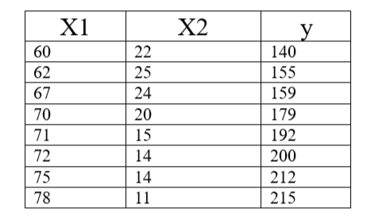
Example: Find the regression line of the following dataset with one response variable y and two predictor variables X1 and X2.

Slide 43
Advantages of Linear Regression
Linear regression is a relatively simple algorithm, making it easy to understand and implement. The coefficients of the linear regression model can be interpreted as the change in the dependent variable for a one-unit change in the independent variable, providing insights into the relationships between variables.
Linear regression is computationally efficient and can handle large datasets effectively. It can be trained quickly on large datasets, making it suitable for real-time applications.
Linear regression is relatively robust to outliers compared to other machine learning algorithms. Outliers may have a smaller impact on the overall model performance.
Linear regression often serves as a good baseline model for comparison with more complex machine learning algorithms.
Linear regression is a well-established algorithm with a rich history and is widely available in various machine learning libraries and software packages.

Slide 44
Disadvantages of Linear Regression
Linear regression assumes a linear relationship between the dependent and independent variables. If the relationship is not linear, the model may not perform well.
Linear regression is sensitive to multicollinearity, which occurs when there is a high correlation between independent variables. Multicollinearity can inflate the variance of the coefficients and lead to unstable model predictions.
Linear regression assumes that the features are already in a suitable form for the model. Feature engineering may be required to transform features into a format that can be effectively used by the model.
Linear regression is susceptible to both overfitting and underfitting. Overfitting occurs when the model learns the training data too well and fails to generalize to unseen data. Underfitting occurs when the model is too simple to capture the underlying relationships in the data.
Linear regression provides limited explanatory power for complex relationships between variables. More advanced machine learning techniques may be necessary for deeper insights.

